Slide 1
Intelligent traffic light based on microcontroller ESP-12E Wi-Fi Module
.

Slide 2
The purpose and objectives of the project
The purpose of attestation work is the development of a microcontroller traffic control device that implements the "green wave" mode on a mobile device command.
To achieve this goal, the following tasks need to be done:
Consider the principles of traffic management using traffic lights
Develop an algorithm for intelligent traffic control.
Choose the technology platform for implementation of the control device.
Run the programming of the microcontroller control unit.
Run mobile device programming
Perform simulation and layout of the developed device.
Notes:
Today, the car is unthinkable without the services of the Internet, aimed at combining a pleasant trip, a comfortable rest and business operations inside the car, which plays the role of a favorite and the only place with a full set of functional services of a business person (voice: communication, communication and mail, banking and navigation as well as music, games, videos).
All this was made possible by connecting the car to the Internet by synchronizing a mobile phone with a monitor (computer) of the vehicle, which allows authenticating the driver in the real world and virtual cyberspace.

Slide 3
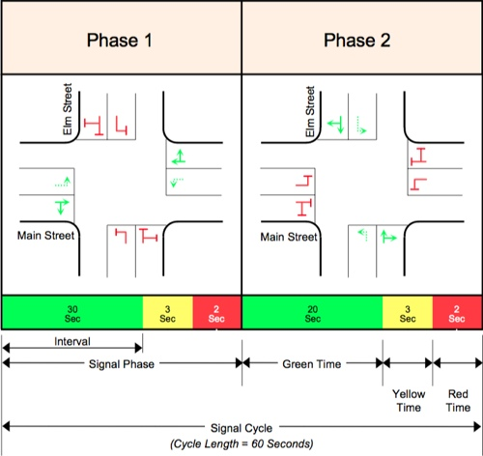
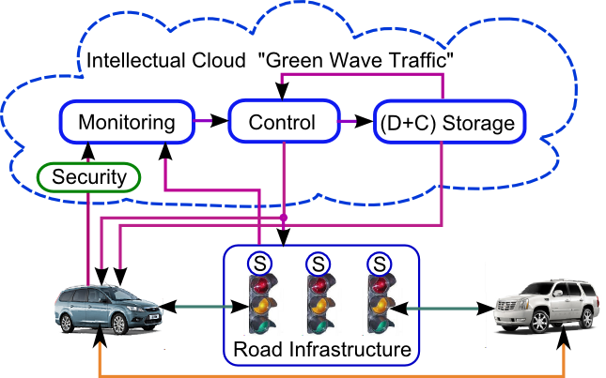
Traffic light working cycles
Time control (Interval). Period of operation of a certain combination of traffic signals.
Phase adjustment (Signal Phase). The set of the main intermediate tact that follows behind it.
Regulatory cycle (Signal Cycle). The set of all phases, which is periodically repeated.
Control section (Split). Percentage of the control cycle, allocated to each of the adjustment phases.
Offset. The difference (in seconds or percentages from the cycle of regulation) between the clock at a specific intersection and the master clock (on the network intersection).
Notes:
The electronic boards, variable information signs, various sensors and camcorders began to appear more and more often on the Ukrainian streets and its highways . Traffic lights are rapidly "smarter", and every self-respecting citytown or village aspires to organize itself as a "center of traffic management." Demand creates a proposal, and some companies are beginning to develop a new direction for them - automation of traffic.
Like any automated control system (ACS), the traffic information (TIACS) is used to receive information "from the fields" or from the operator, process it and generate control actions. Accordingly, it is possible to divide everything that exists in the fields into two groups. The first group collects information, and the second group influences traffic flows.
The first group includes traffic flow detectors, traffic metro stations, CCTV cameras, road signs and electronic displays. The second group includes various road controllers and "smart lights"

Slide 4
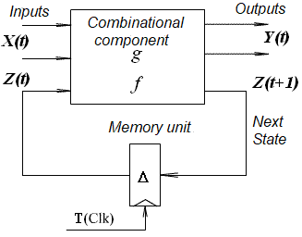




Control Device model of the structural unit
Output function Transition function Change of states Expanded f
Structural Automaton Model (Huffman Model)
The structural automatic machine operates at automatic time, which is measured in steps {t, t + 1, t + 2 ...}, that is, the automatic machine moves from one state to another in one automatic timing cycle.
The duration of the automatic tact can thus be the same for all states of the machine and depends only on the frequency of the synchronous sequence of Clk, but may be different for each state and have a T duration.
The duration of the automaton of the Moore automaton is determined for each state separately.
The automaton transitions graph, which takes into account the duration of the automaton tact for each state of the automaton, will be called the temporal graph of transitions, which is described by the expanded function of transitions.
Notes:
As a control device, a structural automaton, represented by the Huffman model, was used. The peculiarity of this automatic machine is the different length of the automatic tact, which is due to the different lengths of traffic lights cycles.

Slide 5
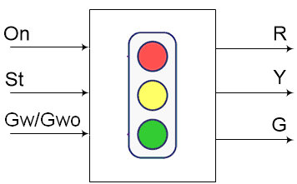
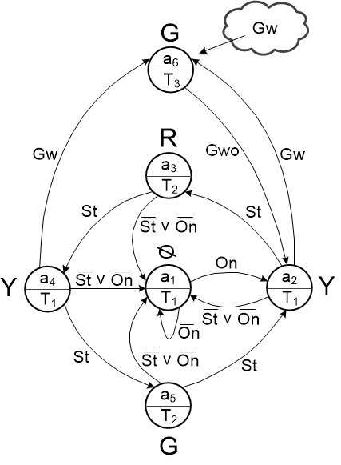
Automatic model of control device
Control automaton transitions temporal graph
Night (emergency) cycle - flashing yellow light of traffic light at interval (delay) T1.
The standard cycle of the traffic light {Y - R - Y - G - Y}, with the delay R, G, will be T2, and the delay Y will be T1.
"Green Wave". By the external signal of the mobile device Gw = 1, the traffic light goes into mode G (outputs the output signal G) and holds it until a reset signal Gwо = 1 is given or the T3 cycle is not completed.
Notes:
Model of control device
Note that the state diagrams of the transitions are not only a visual reflection of the functioning algorithm, but also a complete mathematical model of it.
Incoming actions are divided into events that operate on a short-term basis (for example, sync signals), and input variables that are entered by polling. Incoming actions should be implemented as input variables, and events should be used to reduce the reaction time of the system. In this case, the same input action can be simultaneously presented as an event and an input variable, All outgoing actions are actions, and not acts. The groups of incoming and outgoing actions are associated with the states assigned to each automaton.
The set of inputs X = {On, St, Gw / Gwo}, where On = {0, 1} is the signal including traffic lights, St = {0, 1} is the signal launches the standard cycle of the traffic light, Gw = 1 is the signal (event ) startup mode "green wave" and the Gwo = 1 is in turn signals (events) reset mode "green wave". In the standard operating cycle of the light beam Gw = 1, the green wave mode is switched on. When enabled, the "green wave" signal Gwo = 1 eliminates this ryzhym opposite and puts lights in the standard cycle operation.
A plurality of output signals Y = {R, Y, G}, where R = {Red} - signal including red light, Y = {Yellow} - signal including yellow traffic light, G = {Green} - signal including a green light.

Slide 6
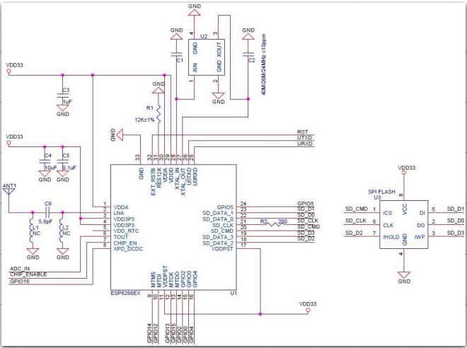
ESP-12E MCU with Wi-Fi Module
Notes:
One of the "breakthroughs" in recent years in the field of wireless solutions is the appeareance of the HYPERLINK ESP8266EX microcontroller unit (MCU) from Espressif Systems. Inexpensive chip with a minimum of external components allows you to get a full Wi-Fi solution and has the following characteristics: - support for Wi-Fi protocols 802.11 b / g / n with WEP, WPA, WPA2 security standards; - support for operating modes: client (STA), access point (AP), client + access point (STA + AP).
ESP8266 offers a complete and standalone Wi-Fi network solution; it can be used to host an application or to remove Wi-Fi functions from another application processor.

Slide 7
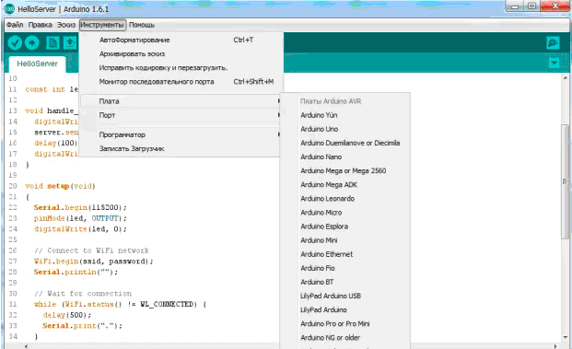
Arduino IDE for ESP8266
Main features of the development environment
Timing and delay. The functions millis and micros return milliseconds and microseconds respectively, which have passed since the module started.
Serial and Serial 1 (UART0 and UART1).
WiFi ESP8266 library (ESP8266WiFi).
Notes:
The firmware (programming) for the microcontroller ESP8266 is implemented using the program in the programming language C in the Arduino IDE environment.The Arduino development environment consists of an embedded text editor of the program code, a message area, text output windows (console), toolbars with frequently used commands and several menus. To download applications and communications, the development environment connects to the hardware part of the Arduino.

Slide 8
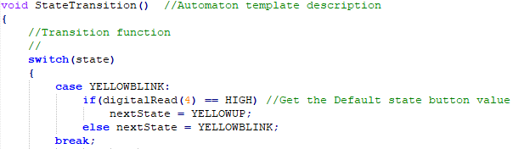
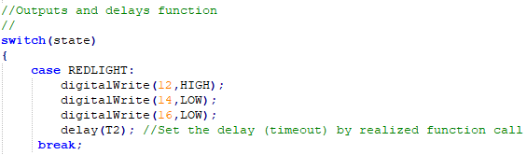
Program code for transition and output functions
Fragment of the transition function
Output function fragment
Notes:
The program has implementrd the principle of "automaton programming". At the implementation stage, a program (in the appropriate programming language or hardware description) is constructed, in which the conversion graphs, input variables, event handlers and output actions are implemented in the form of appropriate language constructs.
Each graph of transitions is formally and isomorphically implemented by a separate function (subroutine), created by a template that contains two constructs of the switch and the if statement. The first design of the switch implements the transition function, and the second construction of the switch activates the output function.
This design is called "automaton pattern"

Slide 9

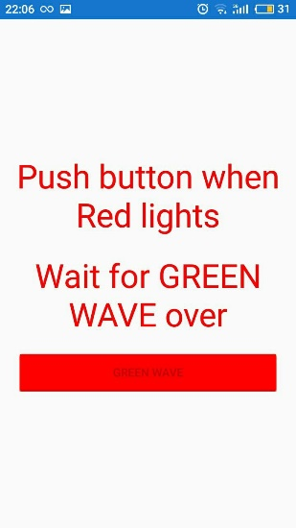
Modes of mobile control device
Activate, lock, and turn off GW mode from a mobile device
Notes:
Specialized vehicles are equipped with appropriate devices, have the opportunity to launch the "green wave" mode when approaching the intelligent traffic signal device. The Gw signal (events) is served using a mobile device that is connected to the Internet and the on-board computer of the vehicle.
As a prototype of this mode, we will use a mobile phone on the Android platform under the protocol http with the address of the server http://192.168.1.1.
As a signal receiver, the ESP8266 MCU with built-in Wi-Fi access point is used. Authentication of the user (special vehicle) at the stage of layout is not carried out.
Activation of the "green wave" mode is carried out by signaling Gw = 1, and the exception is made after the time period T3, or by the event Gwo = 1 (forced reset of the "green wave" mode).

Slide 10
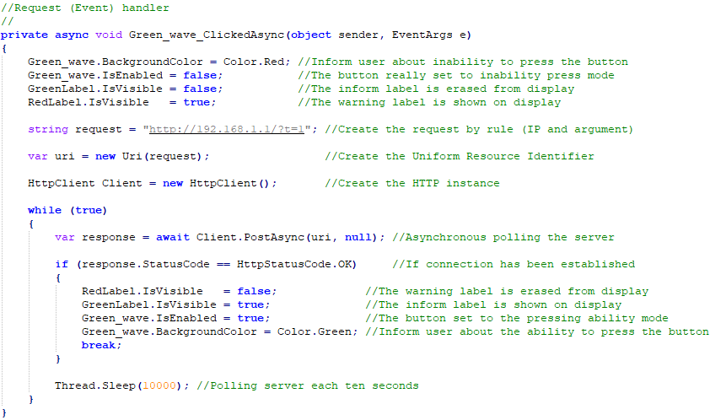
Software code for the mobile application
Notes:
This is a fragment of the mobile application code, which displays the logic of processing the event by clicking the "green wave" mode initialization button.
It should be noted that the application works with an Internet connection, or more precisely with Wi-Fi, configured on the server (ESP8266 microcontroller), so the application without a connection does not work.
Key Features:
· Simple and clear graphical user interface;
· Works when connecting a mobile device with an access point implemented on the microcontroller.
Next on the slide

Slide 11
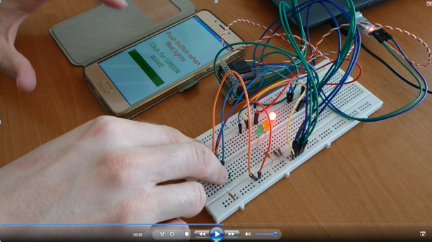
Layout of a mobile control device
Notes:
For the layout of the proposed control device, a mock-up device based on a microcontroller with an ESP-8266 Wi-Fi module is designed. The model of the traffic light is realized on the basis of colored LEDs: red - R314D-L, yellow - LY 2040, green - FYL-5013 UGD. The mobile control device (cloud part of the system) is implemented on the basis of a mobile device on the Android platform.
The work of the device is shown on video (Demo Video.avi). Video description provided by Comments to video.doc

Slide 12
Conclusions
The prototype of the intelligent traffic control device with the support of the "green wave" mode was developed. The "green wave" mode is implemented with a mobile gadget simulating an on-board computer for a special service vehicle.
The algorithm of the intellectual traffic light is represented in the form of a temporal graph with the transition of the control automaton. The control unit is based on the microcontroller with the Wi-Fi module ESP-12E (ESP8266).
The microcontroller is programmed in the programming language SI in the Arduino IDE environment using the automaton template.
The model of the traffic light is realized on the basis of colored LEDs: red - R314D-L, yellow - LY 2040, green - FYL-5013 UGD. The mobile part of the system is implemented on the Android platform in the C # programming language.
The mobile control device (cloud part of the system) is implemented on the basis of a mobile device on the Android platform.

